Slide 1
ACL 2014

Slide 2
Four Oracles
Oracle (Segment on Trans):0.4493
Oracle (Segment on Trans & Edits):0.4844
Oracle(MTurker on Trans):0.3866
Oracle(MTurker on Trans & Edits):0.3916

Slide 3
Other Methods
Random Baseline: 0.3052
Lowest TER: 0.3578
Raw Translation: 0.3889
Sentence Layer Rank:
Trans: 0.3888
Trans & Edits: 0.4083

Slide 4
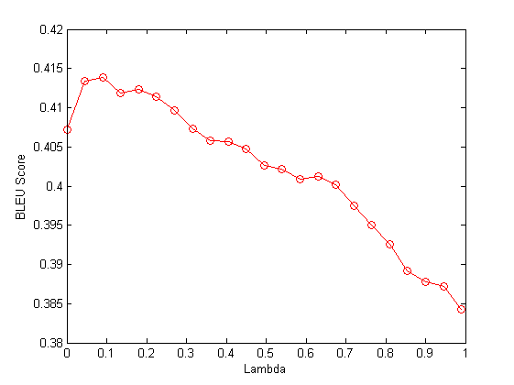
Two Layer Rank
Only Trans: (Climax:0.09 0.4138)

Slide 5
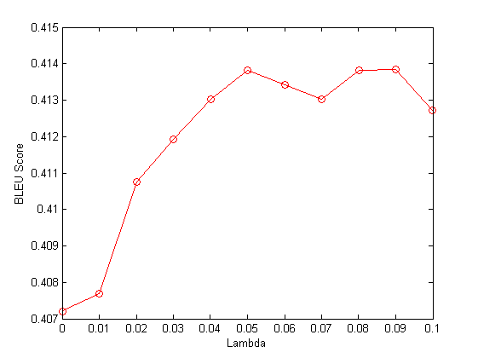
Two Layer Rank
Only Trans: (Climax:0.09 0.4138)

Slide 6
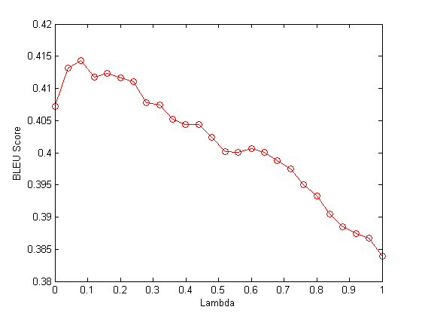
Two Layer Rank
Only Trans & Edits: (Climax:0.08 0.4143)

Slide 7
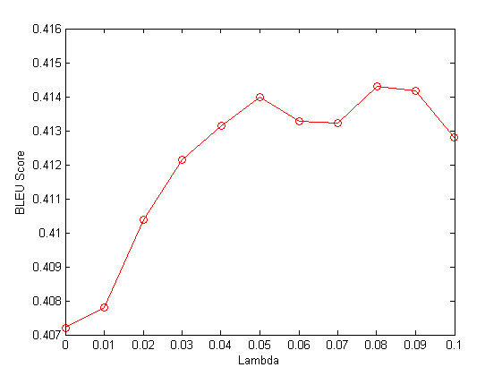
Two Layer Rank
Only Trans & Edits: (Climax:0.08 0.4143)

